Slide 1
December 23, 2022
HIBEAM E5/ESS dimensions
Yuri Kamyshkov/University of Tennessee
kamyshkov@utk.edu

Slide 2
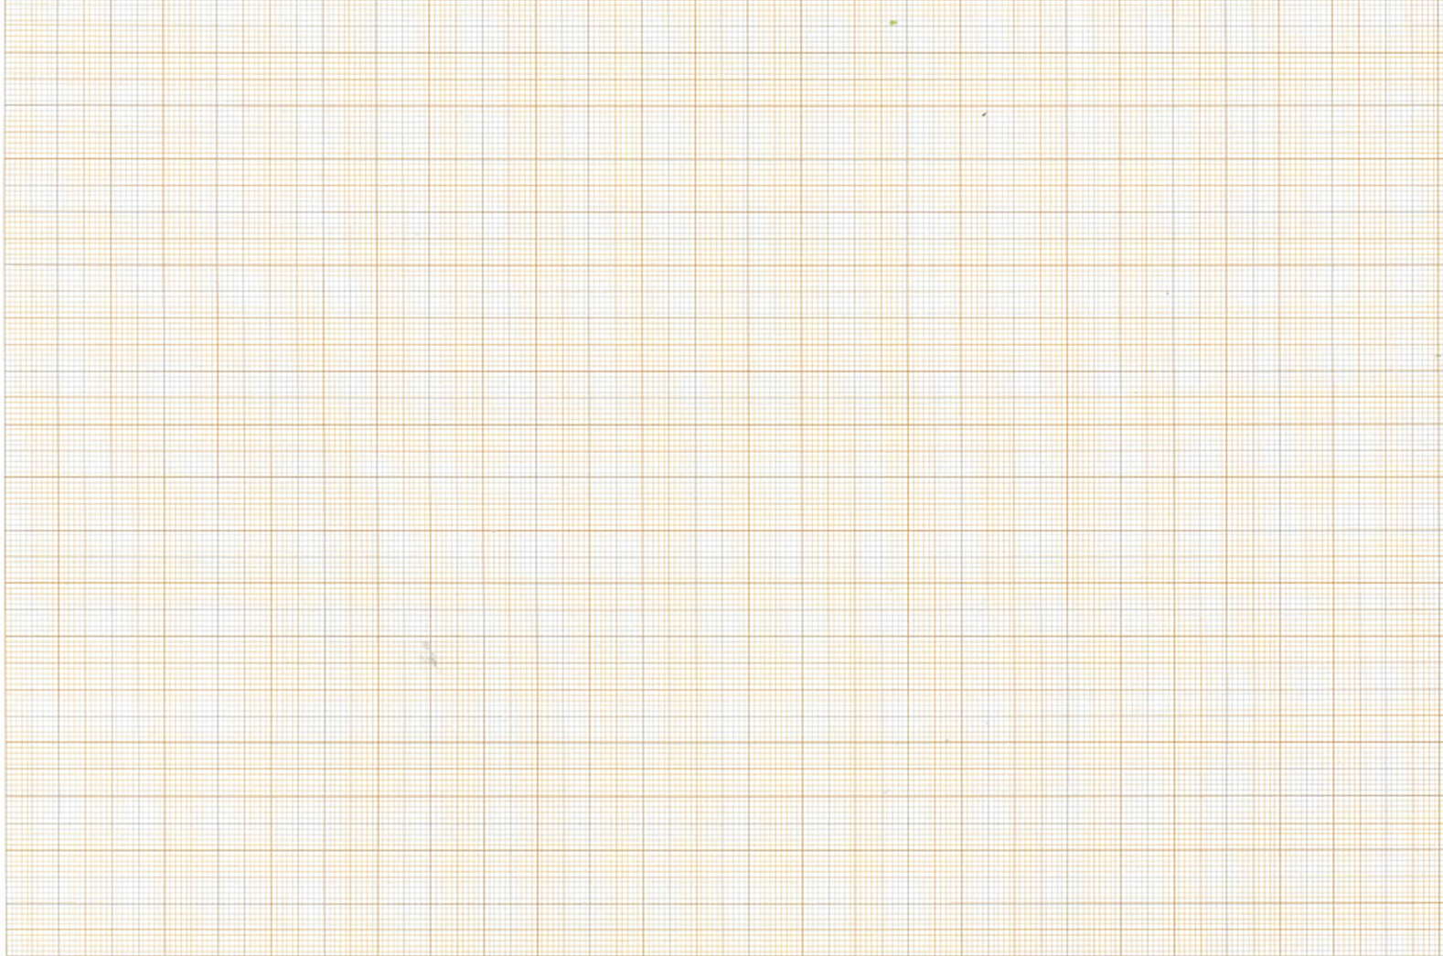
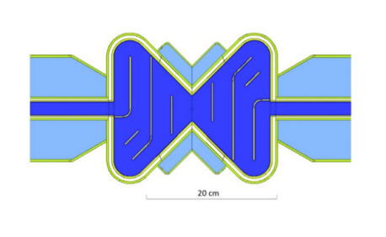
Side View and Top View
Y, X m
Bunker wall
VB ~ 50x50 cm²
Z, m
Is beam axis
at y=+10 cm?
SBP
14x14 cm²
height 1.1 m ?
experimental hall floor

Slide 3
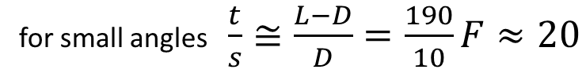

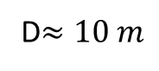

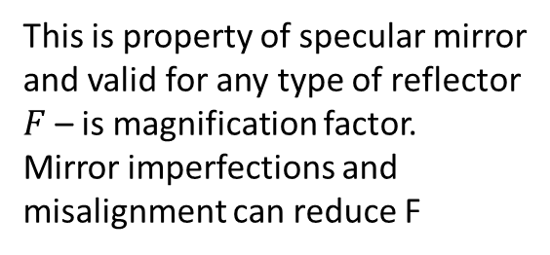
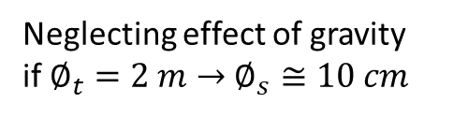
Magnification factor $F$
Neglecting effect of gravity
if $∅_{t}=2 m$ $→$ $∅_{s}≅10 cm$
This is property of specular mirror
and valid for any type of reflector
$F$ – is magnification factor.
Mirror imperfections and
misalignment can reduce F
for small angles $\frac{t}{s}≅\frac{L−D}{D}=\frac{190}{10}F≈20$
D$≈10 m$
$$φ$$
L=200 m
t
s
Small rotation of the mirror element for angle $φ$ efficiently moves the image, but doesn’t change the magnification factor.

Slide 4
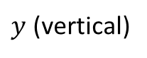
$y$ (vertical)
reflection
ghost
7 cm
source

Slide 5
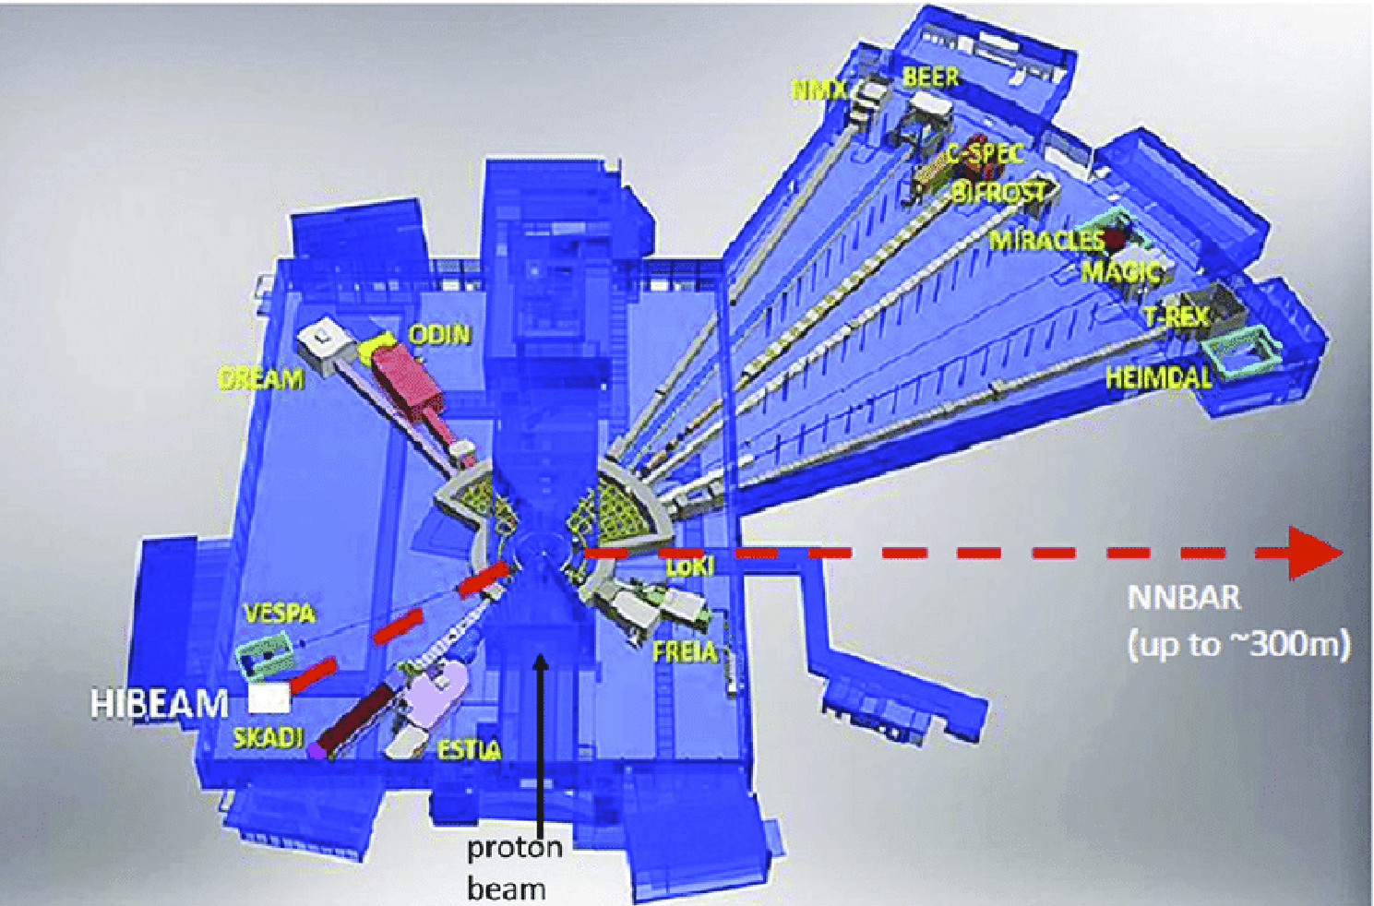
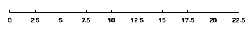
NNbar
protons

Slide 6
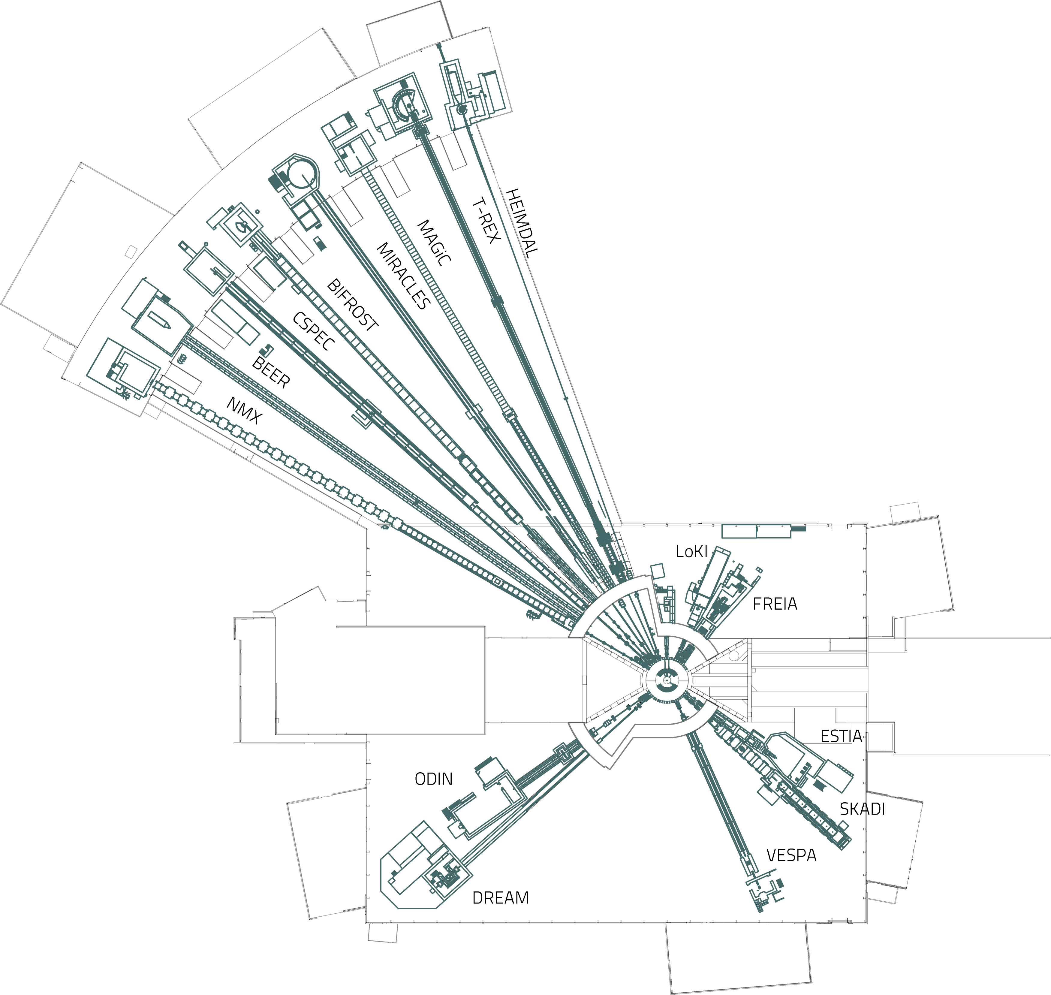
HIBEAM

Slide 7
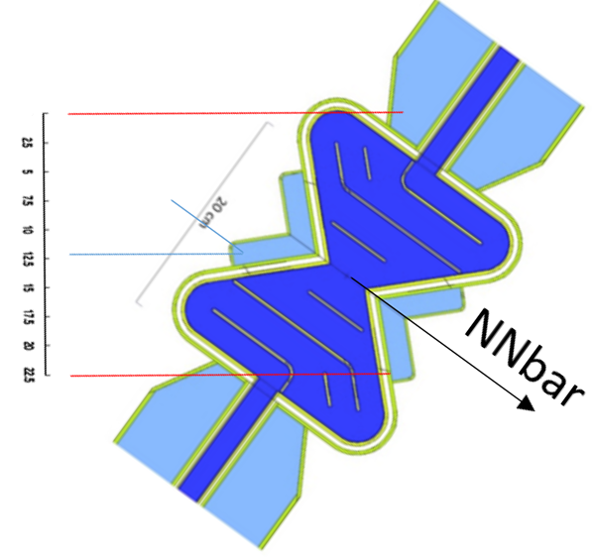
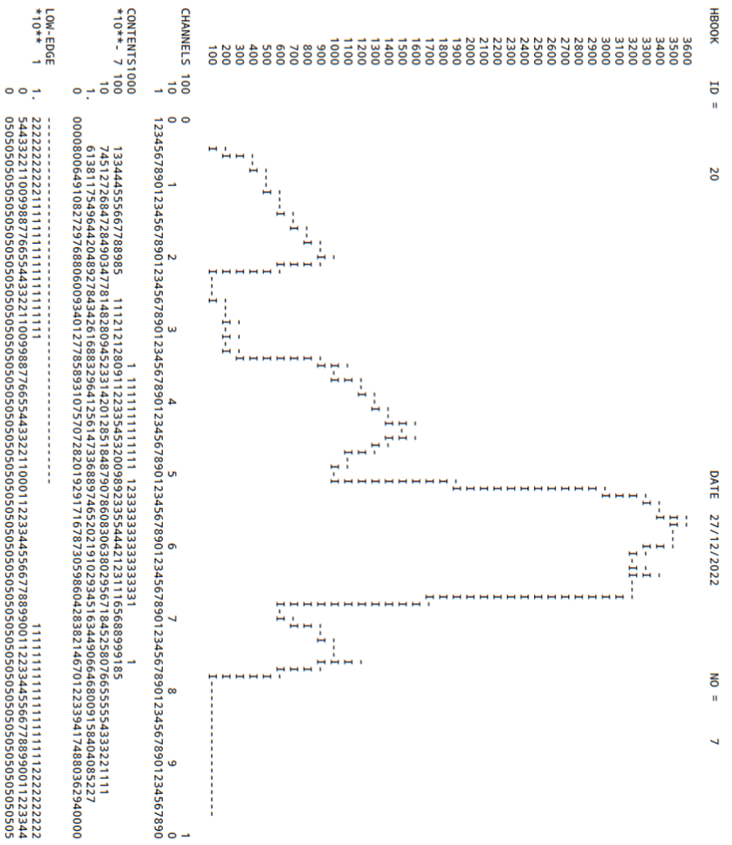

Slide 8
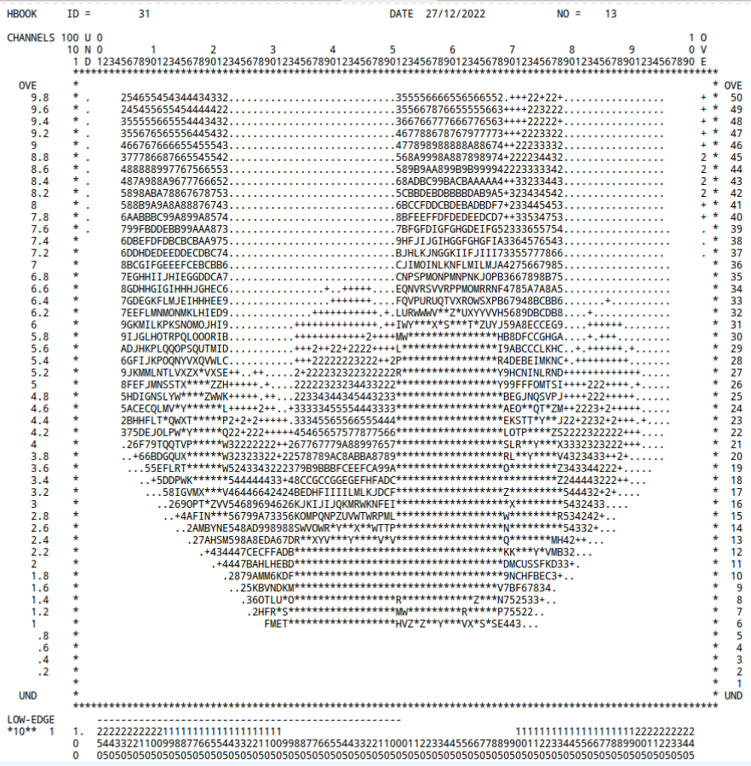
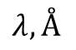
0
wavelength
10
$$λ, Å$$
X-moderator at z=0

Slide 9
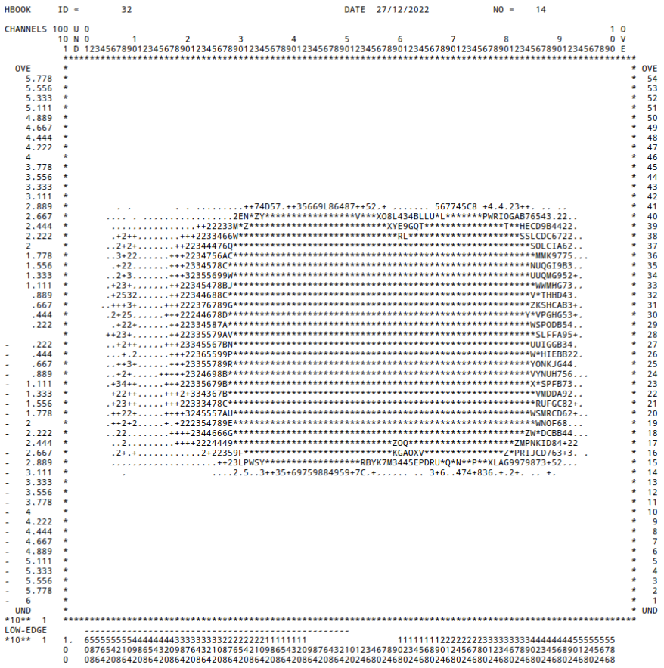

Slide 10
